Slide 1

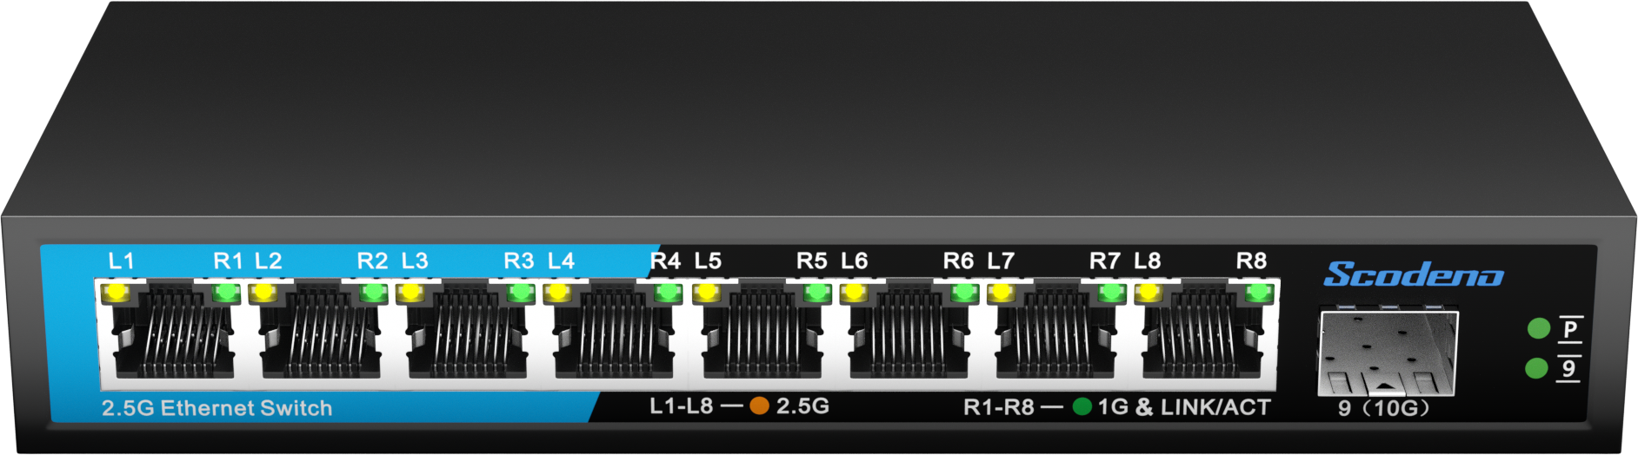

Commercial Ethernet Switch->2.5G Series
8-Port 2.5G Ethernet Switch
1*1/10G SFP+ ports + 8*10/100/1000/2500M RJ45 ports
Non-blocking, low delay design
Strong security policy and strategy
S200-9XH-X
Eco-friendly and energy-saving
| Product Overview
The S200 series of Ethernet switches adopts low power consumption
design, which meets the requirements of green environmental protection and energy saving; all ports support auto-MDI/MDI-X and wire-speed forwarding, ensuring stable and reliable data transmission.
www.scodeno.com

Slide 2
Commercial Ethernet Switch->2.5G Series
| Key Features
4KV port lightning protection;
ESD: contact 6KV, air 8KV；
-10~55℃ wide operating temperature range；
Support MDI/MDIX
| Hardware Features
Model | S200-9XH-X
Interface | 1*1/10G SFP+ ports + 8*10/100/1000/2500M RJ45 ports
Switching Capacity | 60Gbps
Packets Forwarding Rate | 44.64Mpps
MAC | 4K
Port Buffer | 8.1M
Transfer Delay | <10us
Power Supply | DC 12V
 | Empty Load Power: <10W
LED Indicators | PWR,9,Link/act LED
Environment | Working Temperature: –10 ℃ ~ 55℃
 | Storage Temperature: –40 ℃ ~ 85℃
 | Working Humidity: 10%~95% non-condensing
 | Storage Humidity: 10%~95% non-condensing
Size(W*D*H) | 175*73*28mm
Weight | 0.33KG
EMC | Power Surge Protection: 6KV/2KV
 | Ethernet Port Surge Protection: 4KV/2KV
 | Anti-static Interference: 6KV/8KV
 | Free Drop: 0.5M
Certificate Compliance | CE/FCC/RoHS
www.scodeno.com

Slide 3
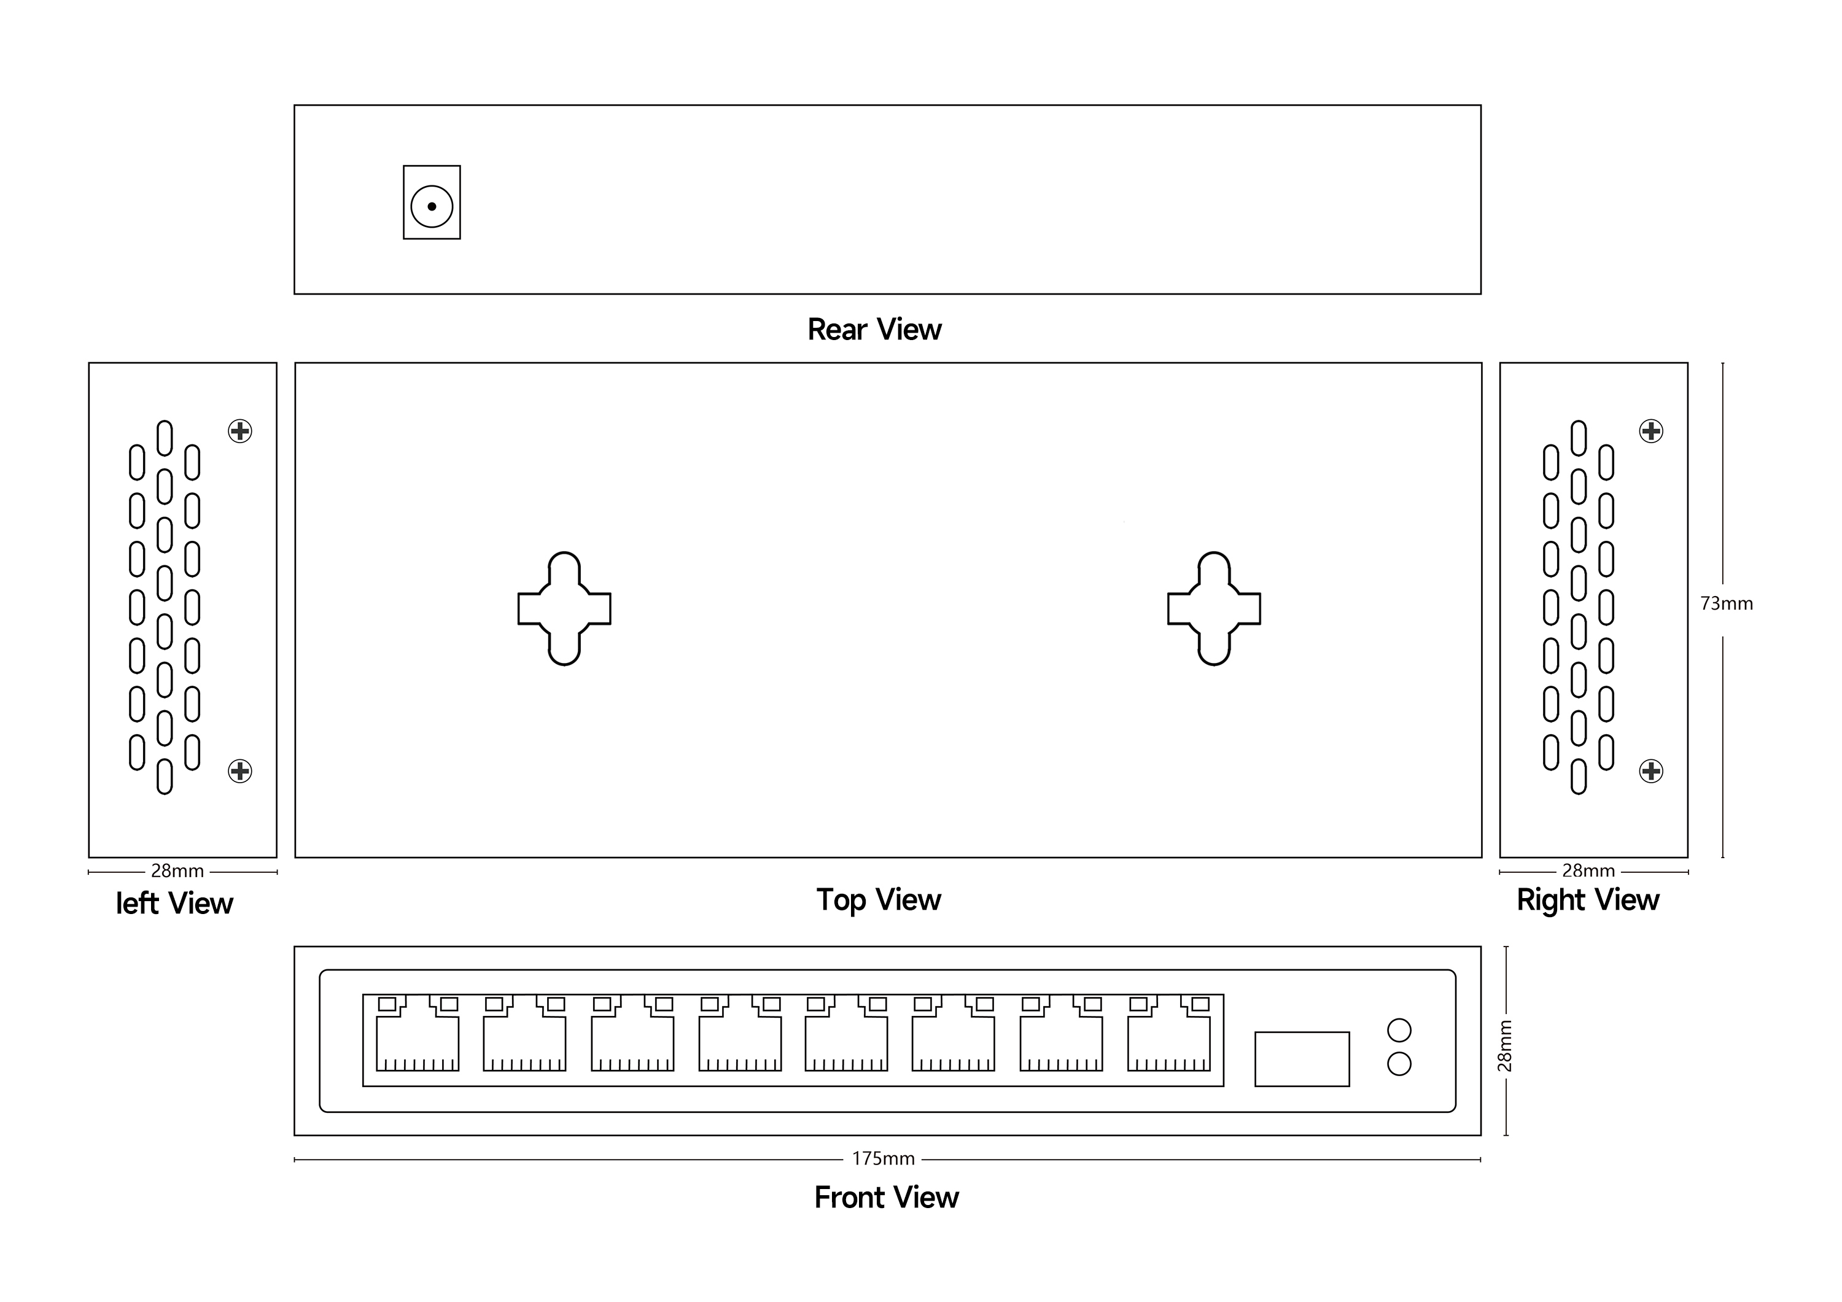
Commercial Ethernet Switch->2.5G Series
| Product Dimensions
www.scodeno.com

