Slide 1
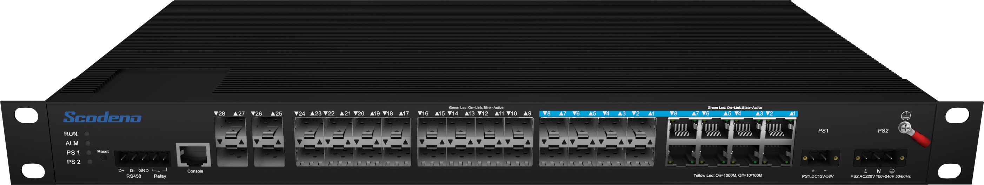





Industrial Ethernet Switch->XPTN-9000-88 Series
L3 Managed Industrial Switch
XPTN-9000-88-4XG16GX8GC-HR-V
XPTN-9000-88-4XG16GX8GC-R-V
Features & Benefits
• Input Voltage: DC12~58V/AC 100~240V 50-60Hz
• Operating Temperature: -40℃~85℃
• Shell: IP40 protection
• Fanless design, low power consumption
• ESD: contact 8KV, air 15KV
• MTBF: 100,000 hours
| Product Introduction
The XPTN-9000 88 Series is specially designed for harsh industrial environments,
which provides economic solutions for industrial Ethernet networking. Support wide working temperature –40℃~85℃.
Redundant AC+DC power supply, adopts rugged aluminum alloy housing, and passed high level tests of EMI/EMC. It also has gone through the strict aging test, meeting the requirements of transportation industry.
| Technical Reference
● IEEE 802.3 CSMA/CD method
● IEEE 802.3x Flow Control
● IEEE 802 Networks
● IEEE 802.3ae 10G Base-X
● ITU-T G.8032 ERPS Ring
● IEEE 802.3 10Base-T
● IEEE 802.3u 100Base-X
● IEEE 802.3u 100Base-FX
● IEEE 802.3z Gigabit SX/LX
● IEEE 802.3ab Gigabit 1000T
www.scodeno.com

Slide 2
Industrial Ethernet Switch->XPTN-9000-88 Series
IEEE 802.3ad port trunk with LACP
IEEE 802.1D Spanning Tree Protocol
IEEE 802.1w Rapid Spanning Tree Protocol
IEEE 802.1s Multiple Spanning Tree Protocol
IEEE 802.1p Class of Service
IEEE 802.1Q VLAN tagging
IEEE 802.1X Port Authentication Network Control
IEEE 802.1ab LLDP
IEEE 802.1ag Connectivity Fault Management(CFM)
RFC 1112 IGMP v1
RFC 2236 IGMP v2
RFC 3376 IGMP v3
RFC783 TFTP
RFC 791 IP
RFC 792 ICMP
RFC 2068 HTTP
RFC 2616 HTTPS
| EMC & Protection
IP Class: IP40
Surge of Power: AC: IEC 61000-4-5 Level X（6KV/2KV）（1.2/50us）
    DC: IEC 61000-4-5 Level X（8KV/8KV）（1.2/50us）
Surge of Ethernet Port: IEC 61000-4-5 Level 4（4KV/2KV)（10/880us）
RS: IEC 61000-4-3 Level 3（10V/m）
EFI:IEC 61000-4-4 Level 3（1V/2V）
CS: IEC 61000-4-6 Level 3（10V/m）
PFMF: IEC 61000-4-8 Level 4（30A/m）
DIP:IEC 61000-4-11 Level 3（10V）
ESD: IEC 61000-4-2 Level 4 (8K/15K）
Free Fall: 0.5m
| Hardware Specifications
Model | XPTN-9000-88-4XG16GX8GC-HR-V | XPTN-9000-88-4XG16GX8GC-R-V
Interface | 4*10G SFP ports +8*1000M combo ports + 16*10/100/1000M SFP ports
Switching Capacity | 160Gbps
Packets Forwarding Rate | 95.23Mpps
MAC Table | 16K
www.scodeno.com

Slide 3
Industrial Ethernet Switch->XPTN-9000-88 Series
Packet Buffer | 12M
Forwarding Delay | <10us
Power Supply | Phoenix terminal, AC+DC power supply
 | Input Voltage:DC12-58V/AC 100-240V 50-60HZ | Input Voltage: DC48-58V
 | Empty Load Power: <36W
LED Indicators | PWR，Link/ACTLED
Environment | Working Temperature: –40℃ ~ 85℃
 | Storage Temperature: –40℃ ~ 85℃
 | Working Humidity: 5%~95% non-condensing
 | Storage Humidity: 5%~95% non-condensing
SIZE(W*D*H) | 440*245*44mm
Weight | 3.6KG | 3.62KG
Installation Method | Rack mounted
Certificate Compliance | CE/FCC/RoHS
MTBF | 100,000 hours
| Software Specifications
Model | XPTN-9000-88-4XG16GX8GC-HR-V | XPTN-9000-88-4XG16GX8GC-R-V
VLAN | Support 4K IEEE 802.1Q VLAN
 | Support protocol VLAN
 | Support GARP
LACP | Support IEEE 802.3ad
 | Support static LACP
 | Support dynamic LACP
www.scodeno.com

Slide 4
Industrial Ethernet Switch->XPTN-9000-88 Series
Model | XPTN-9000-88-4XG16GX8GC-HR-V | XPTN-9000-88-4XG16GX8GC-R-V
STP | Support IEEE 802.1d STP
 | Support IEEE 802.1w RSTP
 | Support IEEE 802.1s MSTP
ERPS | Support ITUT G.8032 protocol
Port | Support Jumbo Frame
 | Support IEEE802.3X Flow Control
 | Support port statistics
 | Support Auto-MDI/MDIX
Multicast | Support IGMP Snooping
ACL | Support MAC Standard/Extended ACL
 | Support IPv4 Standard/Extended ACL
 | Support IPv6 Standard/Extended ACL
QoS | Support QoS Re-marking
 | Support Port Trust
 | Support Port Rate Limiting
 | Support Egress Queue Rate Limiting
DHCP | Support DHCP Snooping
 | Support DHCP Client
 | Support DHCP Server
L3 Route | IPv4 Management Address
 | IPV6 Management Address
 | Static IPv4 Route
 | Static IPv6 Route
 | RIP,OSPF
 | IS-IS
 | ARP
 | Loopback Interface
www.scodeno.com

Slide 5
Industrial Ethernet Switch->XPTN-9000-88 Series
Model | XPTN-9000-88-4XG16GX8GC-HR-V | XPTN-9000-88-4XG16GX8GC-R-V
Security | Support IEEE802.1X
 | Support MAC-Based IEEE802.1X
 | Support WEB-Based IEEE802.1X
 | IP Source Guard
 | Port Security
 | Port Isolation
Diagnosis | Support Console Logs
 | Support RAM logs
 | Support Flash logs
 | Support Port Mirroring(1:1)
Diagnosis | Support Ping
 | Support Traceroute
 | Support Cable Test
 | Support Optical Module Information
Management | Support User Management
 | Support System Log
 | Support Firmware Upgrade
 | Support File Upgrade
 | Support SNMP
 | Support WEB Management
 | Support Console
 | Support CLI
 | Support Telnet/SSH
EEE | Support IEEE802.3az
www.scodeno.com

Slide 6
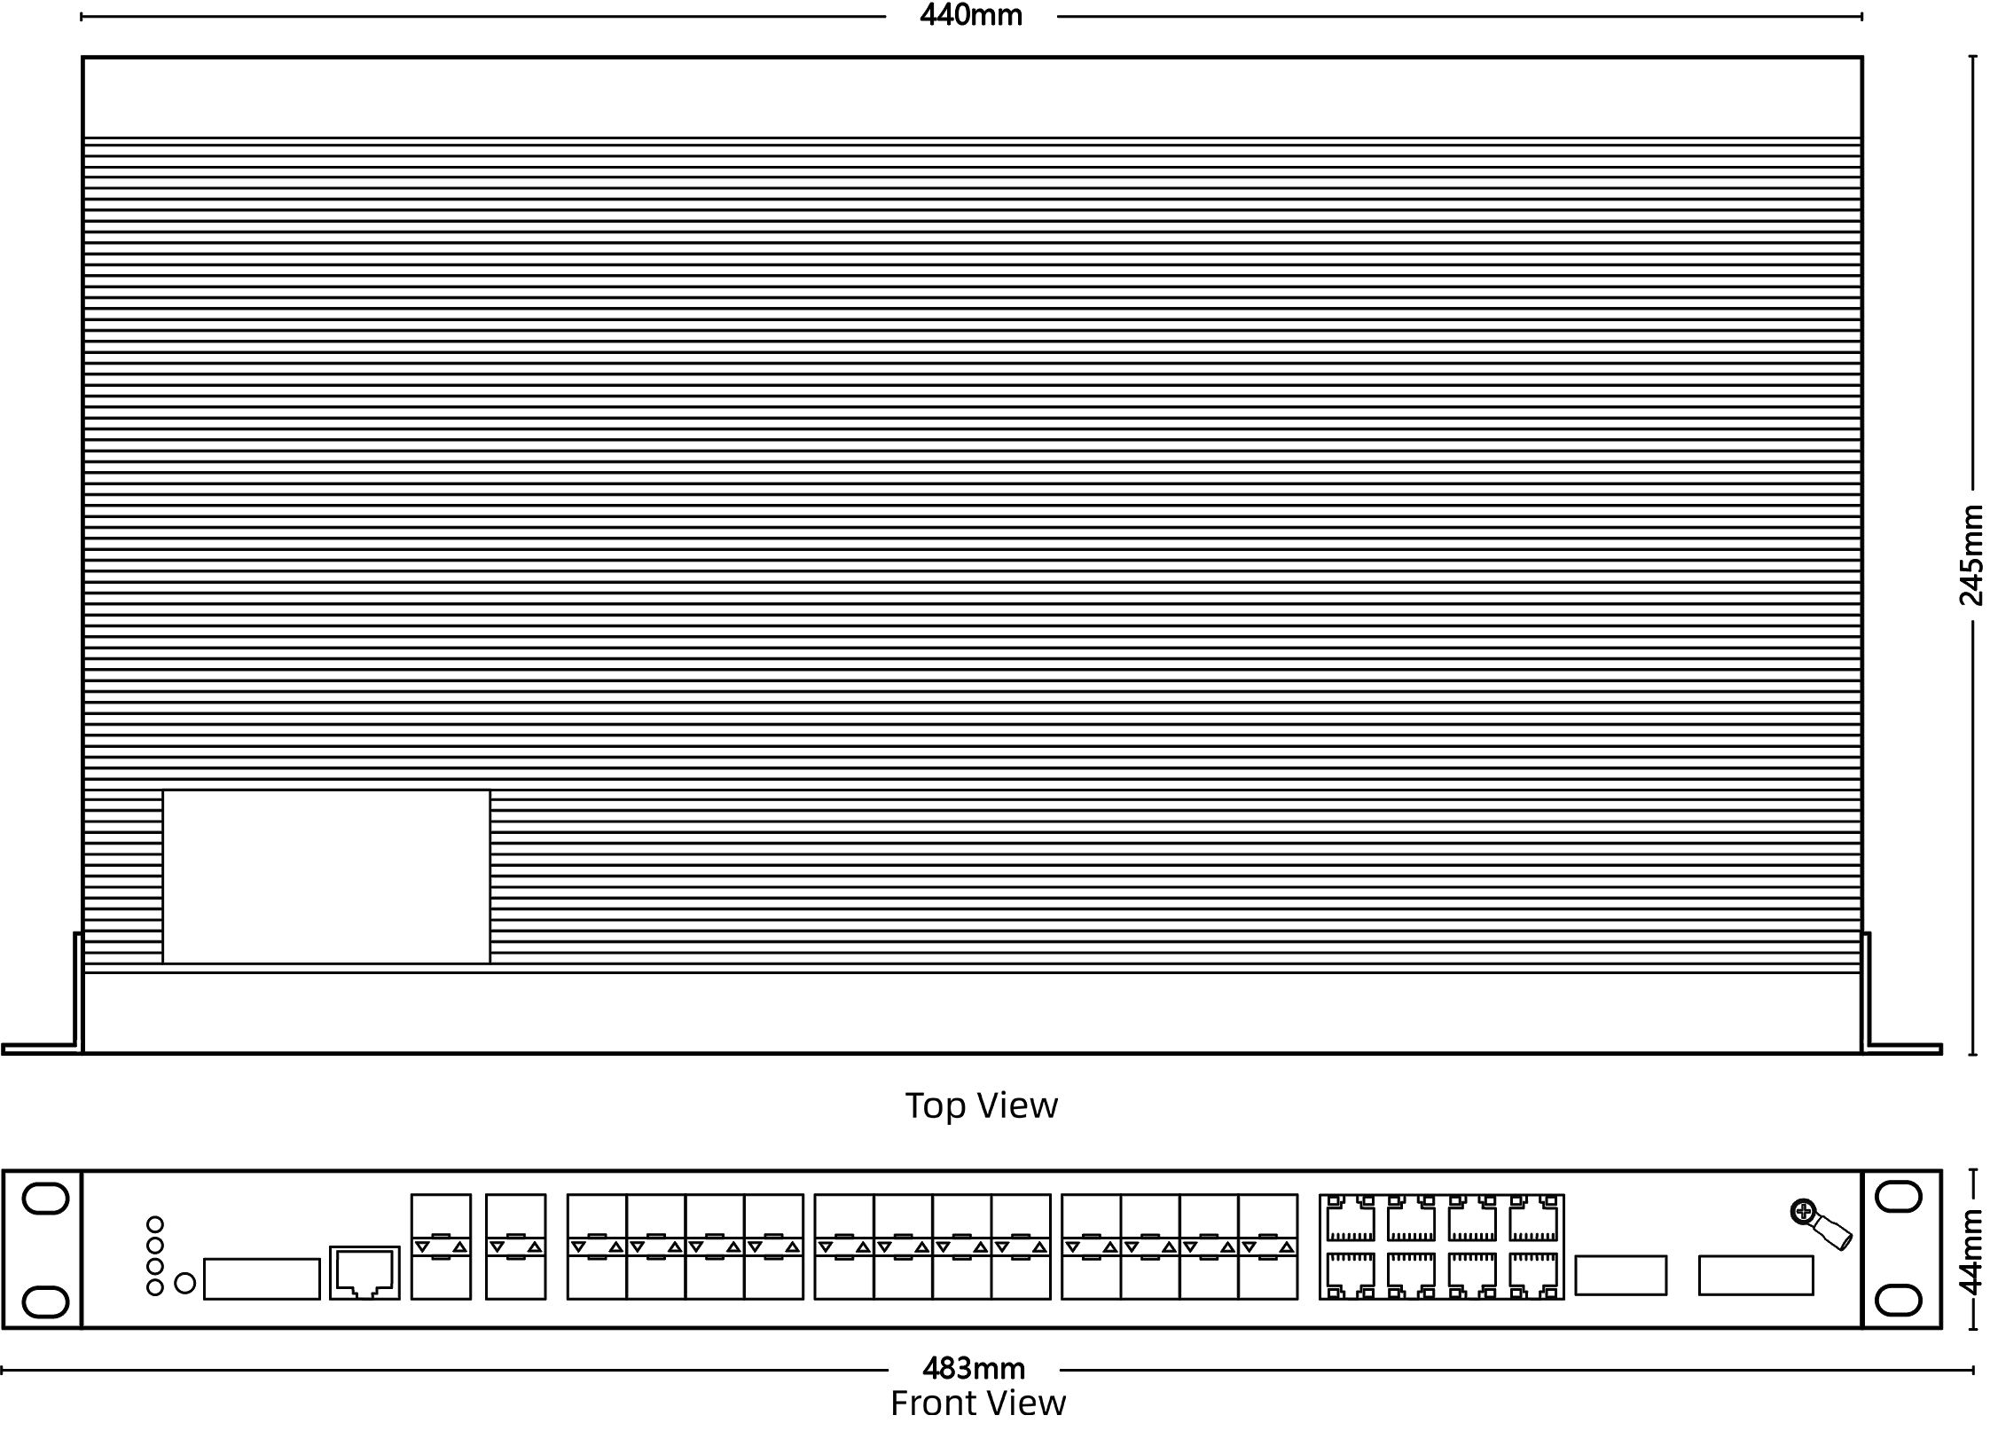
Industrial Ethernet Switch->XPTN-9000-88 Series
| Product Dimension
www.scodeno.com

