Slide 1
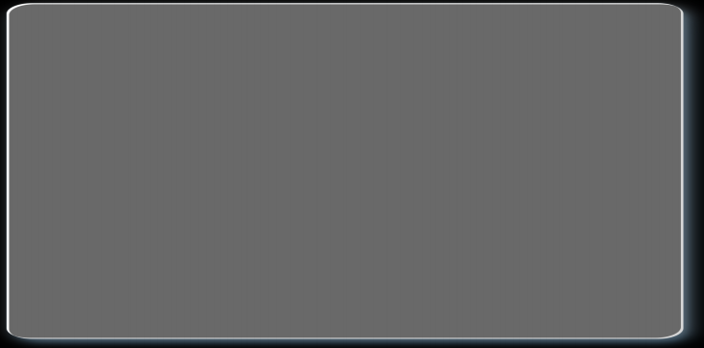
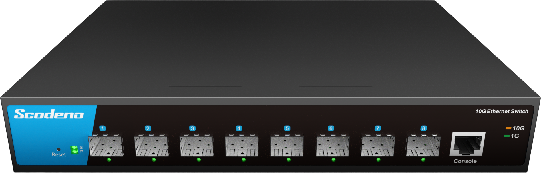



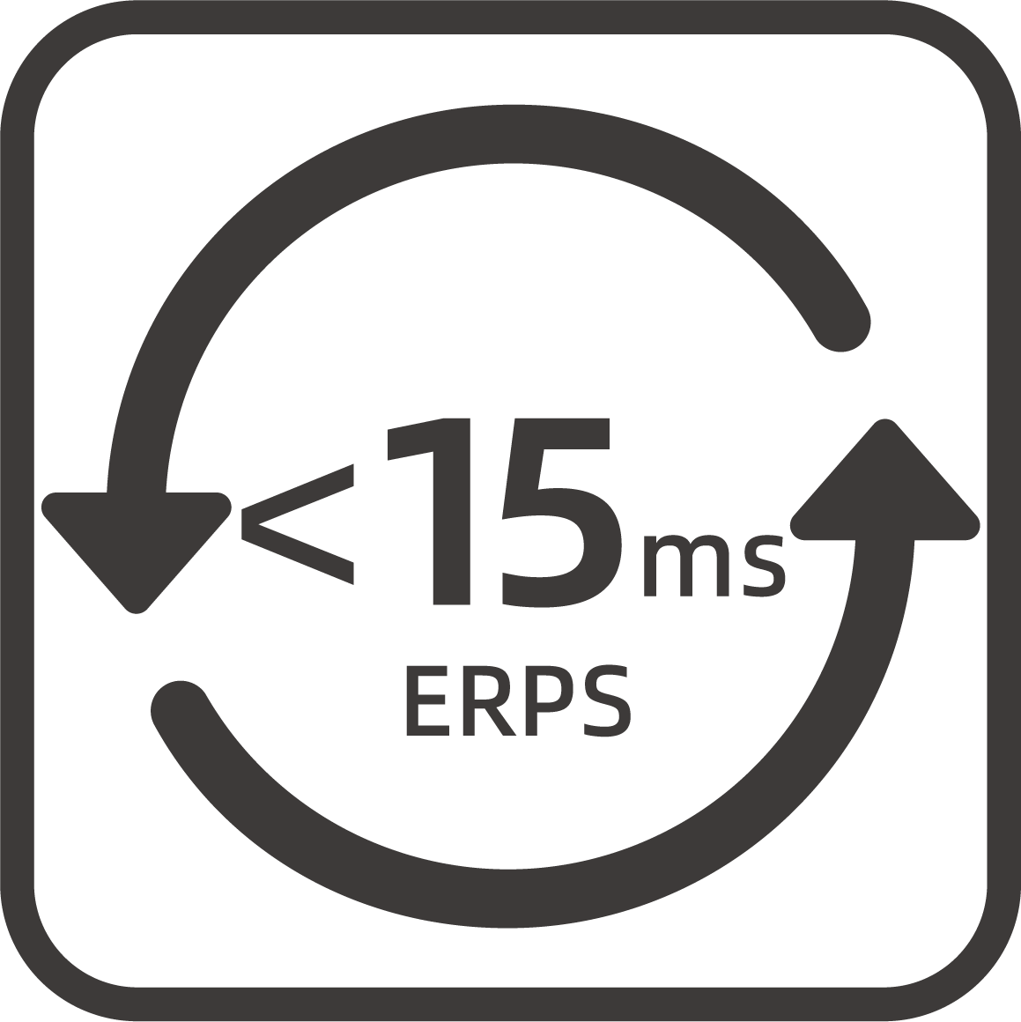
Commercial Ethernet Switch->10G Series
Commercial Ethernet Switch->10G Series
8-Port 10G L3 10G Ethernet Switch
8x10G SFP+ Ports
Multiple management methods
Non-blocking, low delay design
Rich in L2/L3 features
Strong security policy and strategy
S200-8XM-AC
Eco-friendly and energy-saving
| Product Overview
The S200 series of management switches adopts low power consumption
design, which meets the requirements of green environmental protection and energy saving; Rich L2/L3 functional features to meet different
business requirements; Powerful security policies and rich security
features ensure network security; The management platform is simple
and easy to use, greatly facilitating the operation and maintenance
methods of management personnel.
www.scodeno.com

Slide 2
Commercial Ethernet Switch->10G Series
| Key Features
ESD: contact 8KV, air 15KV；
-10~55℃ wide operating temperature range；
Support static routing function；
Support dynamic routing such as OSPF, RIP etc ;
Support L2 management functions such as VLAN, LLDP, LACP etc.；
Support rich security features such as 802.1X, AAA, Port Security, DHCP Snooping, Port Isolation, DAI etc.；
Support Telnet/SSH, SNMP, WEB UI, CLI, and management.
| Hardware Features
Model | S200-8XM-AC
Interface | 8*1/10G SFP+ ports
 | 1*Console Management
Switching Capacity | 160Gbps
Packets Forwarding Rate | 119.04Mpps
MAC Table | 16K
Packet Buffer | 12M
Transfer Delay | <10us
Power Supply | AC100-240V 50/60HZ
 | Empty Load Power: <35W
LED Indicators | PWR,SYS, Link/ACT
Environment | Working Temperature: –10 ℃ ~ 45℃
 | Storage Temperature: –40 ℃ ~ 85℃
 | Working Humidity: 10%~95% non-condensing
 | Storage Humidity: 10%~95% non-condensing
Size(W*D*H) | 270*181*44mm
www.scodeno.com

Slide 3
Commercial Ethernet Switch->10G Series
Model | S200-8XM-AC
Weight | 1.25KG
EMC | Power Surge Protection: 6KV/2KV
 | Anti-static Interference: 8KV/15KV
 | Free Drop: 0.5M
Certificate Compliance | CE/FCC/RoHS
| Software Specifications
Model | S200-8XM-AC
VLAN | Support 4K IEEE 802.1Q VLAN
 | Support protocol VLAN
 | Support MAC VLAN
 | Support voice VLAN
 | Support video VLAN
 | Support GARP
LACP | Support IEEE 802.3ad
 | Support static LACP
 | Support dynamic LACP
STP | Support IEEE 802.1d STP
 | Support IEEE 802.1w RSTP
 | Support IEEE 802.1s MSTP
 | Spanning Tree BPDU Filtering
 | Spanning Tree BPDU Guard
 | Spanning Tree Edge Port
LLDP | Support IEEE 802.1ab protocol
www.scodeno.com

Slide 4
Commercial Ethernet Switch->10G Series
Model | S200-8XM-AC
ERPS | Support ITUT G.8032 protocol
Port | Support Jumbo Frame
 | Support IEEE802.3X Flow Control
 | Support port statistics
 | Support Auto-MDI/MDIX
Multicast | Support IGMP Snooping
 | Support MLD Snooping
 | Support MVR
ACL | Support MAC Standard/Extended ACL
 | Support IPv4 Standard/Extended ACL
 | Support IPv6 Standard/Extended ACL
QoS | Support QoS Re-marking
 | Support Port Trust
 | Support Port Rate Limiting
 | Support Egress Queue Rate Limiting
 | Support SP, WRR scheduling algorithms
 | Support CoS, DSCP, IP Priority Mapping
DHCP | DHCP Interface Priority IP Binding
 | Support DHCP Snooping
 | Support DHCP Client
 | Support DHCP Server
L3 Route | IPv4 Management Address
 | IPV6 Management Address
 | Static IPv4 Route
 | Static IPv6 Route
 | OSPF, RIP
 | ARP
 | Loopback Interface
Security | Support Management Channel Configuration
 | Support AAA
 | Support IEEE802.1X
 | Support MAC-Based IEEE802.1X
www.scodeno.com

Slide 5
Commercial Ethernet Switch->10G Series
Model | S200-8XM-AC
Security | Support WEB-Based IEEE802.1X
 | Denial of Service Protection
 | Dynamic ARP Inspection(DAI)
 | IP Source Guard
 | Port Security
 | Port Isolation
DNS | Support DNS Client
 | Support DNS Server
Diagnosis | Support Console Logs
 | Support RAM logs
 | Support Flash logs
 | Support Port Mirroring(1:1,N:1)
 | Support Ping
 | Support Traceroute
 | Support Cable Test
 | Support UDLD protocol
 | Support Optical Module Information
Management | Support User Management
 | Support System Log
 | Support Firmware Upgrade
 | Support File Upgrade
 | Support SNMP
 | Support WEB Management
 | Support Console
 | Support CLI
 | Support Telnet/SSH
 | Support SNTP Client
 | Support RMON
EEE | Support IEEE802.3az
www.scodeno.com

Slide 6
Commercial Ethernet Switch->10G Series
| Product Dimensions
www.scodeno.com

