Slide 1
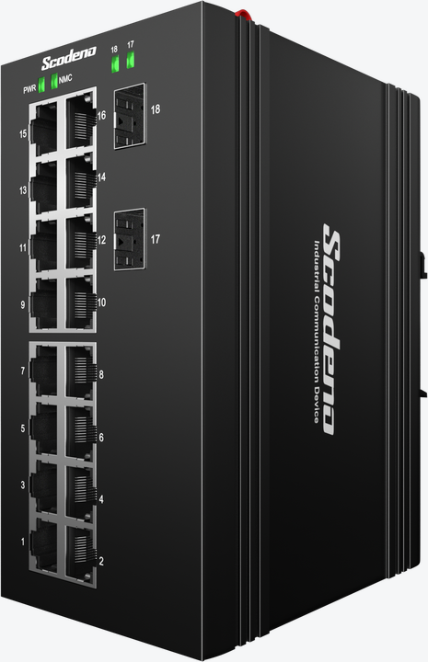





Industrial Ethernet Switch->XPTN-9000-77 Series
L2+ Managed Industrial Switch
XPTN-9000-77-2GX16GP-V
XPTN-9000-77-2GX16GT-V
Features & Benefits
• Input Voltage: DC12~58V for Non-PoE, DC48~58V for PoE
• Operating Temperature: -40℃~85℃
• Shell: IP40 protection
• Fanless design, low power consumption
• ESD: contact 8KV, air 15KV
• MTBF: 100,000 hours
| Product Introduction
The XPTN-9000-77 Series is L2+ managed switch, specially designed for harsh industrial environments,which provides economic solutions for industrial Ethernet networking. Support wide working temperature –40 ℃~85℃ .
Redundant DC power supply, adopts rugged aluminum alloy housing, and passed high level tests of EMI/EMC. It also has gone through the strict aging test, meeting the requirements of transportation industry.
| Technical Reference
● IEEE 802.3 CSMA/CD method
● IEEE 802.3 af PoE
● IEEE 802.3 at PoE+
● IEEE 802.3x Flow Control
● IEEE 802 Networks
● IEEE 802.3 10Base-T
● IEEE 802.3u 100Base-TX/FX
●IEEE 802.3z Gigabit SX/LX
●
IEEE 802.3ab Gigabit 1000T
IEEE 802.3ad port trunk with LACP
IEEE 802.1D Spanning Tree Protocol
IEEE 802.1w Rapid Spanning Tree Protocol
IEEE 802.1s Multiple Spanning Tree Protocol
IEEE 802.1p Class of Service
www.scodeno.com

Slide 2
Industrial Ethernet Switch->XPTN-9000-77 Series
IEEE 802.1Q VLAN tagging
IEEE 802.1X Port Authentication Network Control
IEEE 802.1ab LLDP
IEEE 802.1ag Connectivity Fault Management(CFM)
RFC 1112IGMP v1
RFC 2236 IGMP v2
RFC 3376IGMP v3
RFC783 TFTP
RFC 791 IP
RFC 792 ICMP
RFC 2068 HTTP
RFC 2616 HTTPS
ITU-T G.8032 ERPS Ring
| EMC & Protection
IP Level: IP40
Surge of Power: IEC 61000-4-5 Level X（6KV/6KV）（1.2/50us）
Surge of Ethernet port: IEC 61000-4-5 Level 4（4KV/4KV）（10/700us）
RS: IEC 61000-4-3 Level 3（10V/m）
EFI:IEC 61000-4-4 Level 3（1V/2V）
CS: IEC 61000-4-6 Level 3（10V/m）
PFMF: IEC 61000-4-8 Level 4（30A/m）
DIP:IEC 61000-4-11 Level 3（10V）
ESD:IEC 61000-4-2 Level 4（8K/15K）
Free fall: 0.5m
| Hardware Specifications
Model | XPTN-9000-77-2GX16GT-V | XPTN-9000-77-2GX16GP-V
Interface | 2*1000M SFP ports + 16*10/100/1000M RJ45 ports
Switching Capacity | 68Gbps
Packets Forwarding Rate | 50.59Mpps
MAC Table | 16K
Packet Buffer | 12M
Forwarding Delay | <10us
www.scodeno.com

Slide 3
Industrial Ethernet Switch->XPTN-9000-77 Series
Power Supply | Phoenix terminal, DC redundant input
 | Input Voltage: DC12-58V | Input Voltage: DC48-58V
 | Empty Load Power: <26W
LED Indicators | PWR, NMC,Link/ACT LED
PoE | __ | 1-16 ports support PoE
 |  | PoE budget: 386W
 |  | IEEE802.3 af/at standard
 |  | PIN Sequence: 1,2+/3,6-
Environment | Working Temperature: –40 ℃ ~ 85℃
 | Storage Temperature: –40 ℃ ~ 85℃
 | Working Humidity: 5%~95% non-condensing
 | Storage Humidity: 5%~95% non-condensing
SIZE(W*D*H) | 143*104*75mm
Weight | 0.8KG | 0.85KG
Installation Method | Din Rail
Certificate Compliance | CE/FCC/RoHS
MTBF | 100,000 hours
| Software Specifications
Model | XPTN-9000-77-2GX16GT-V | XPTN-9000-77-2GX16GP-V
VLAN | Support 4K IEEE 802.1Q VLAN
 | Support protocol VLAN
 | Support GARP
LACP | Support IEEE 802.3ad
 | Support static LACP
 | Support dynamic LACP
STP | Support IEEE 802.1d STP
 | Support IEEE 802.1w RSTP
 | Support IEEE 802.1s MSTP
ERPS | Support ITUT G.8032 protocol
www.scodeno.com

Slide 4
Industrial Ethernet Switch->XPTN-9000-77 Series
Model | XPTN-9000-77-2GX16GT-V | XPTN-9000-77-2GX16GP-V
Port | Support Jumbo Frame
 | Support IEEE802.3X Flow Control
 | Support port statistics
 | Support Auto-MDI/MDIX
Multicast | Support IGMP Snooping
 | Support MVR
ACL | Support MAC Standard/Extended ACL
 | Support IPv4 Standard/Extended ACL
 | Support IPv6 Standard/Extended ACL
QoS | Support QoS Re-marking
 | Support Port Trust
 | Support Port Rate Limiting
 | Support Egress Queue Rate Limiting
DHCP | Support DHCP Snooping
 | Support DHCP Client
 | Support DHCP Server
L3 Route | IPv4 Management Address
 | IPV6 Management Address
 | Static IPv4 Route
 | Static IPv6 Route
 | ARP
 | Loopback Interface
Security | Support IEEE802.1X
 | Support MAC-Based IEEE802.1X
 | Support WEB-Based IEEE802.1X
 | IP Source Guard
 | Port Security
 | Port Isolation
Diagnosis | Support Console Logs
 | Support RAM logs
 | Support Flash logs
 | Support Port Mirroring(1:1,N:1)
www.scodeno.com

Slide 5
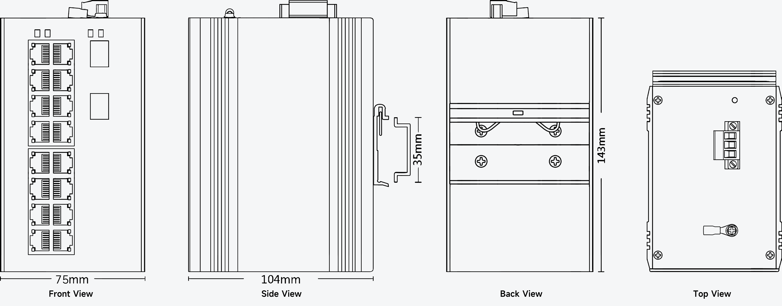
Industrial Ethernet Switch->XPTN-9000-77 Series
Model | XPTN-9000-77-2GX16GT-V | XPTN-9000-77-2GX16GP-V
Diagnosis | Support Ping
 | Support Traceroute
 | Support Cable Test
 | Support Optical Module Information
Management | Support User Management
 | Support System Log
 | Support Firmware Upgrade
 | Support File Upgrade
 | Support SNMP
 | Support WEB Management
 | Support Console
 | Support CLI
 | Support Telnet/SSH
| Product Dimension
www.scodeno.com

