Slide 1

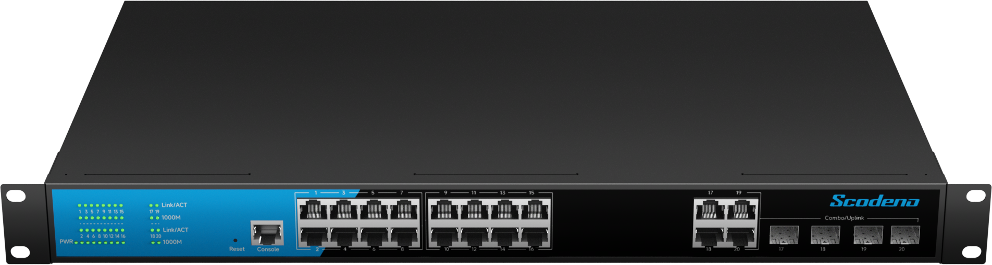
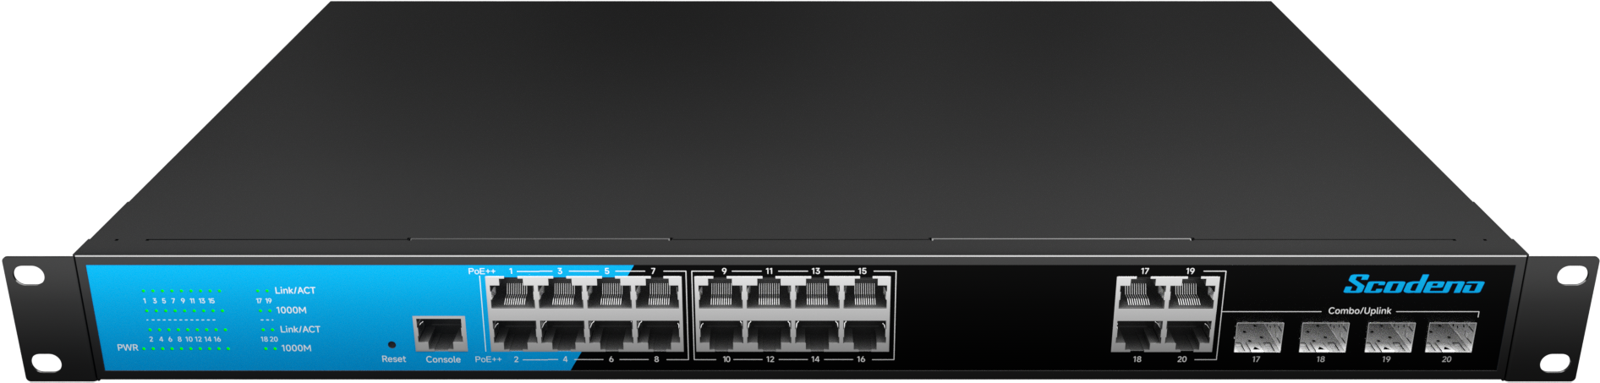



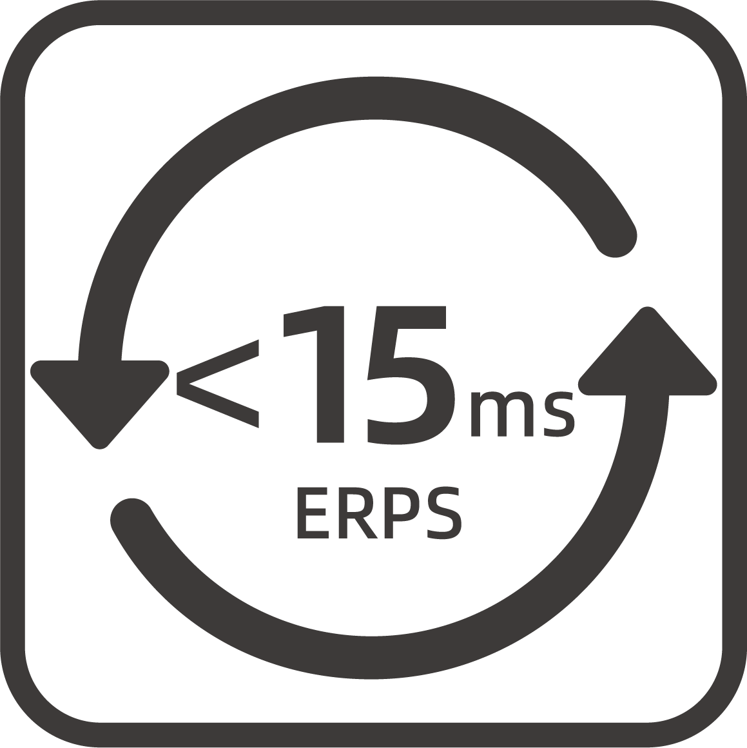

Commercial Ethernet Switch->2.5G Series
Commercial Ethernet Switch->2.5G Series
16-Port Gigabit L2+ Managed Ethernet Switch
4*100/1000M Combo Ports + 16*10/100/1000M RJ45 Ports
Multiple management methods
S200-20GCM-C4-ACR
Non-blocking, low delay design
Rich in L2/L3 features
Strong security policy and strategy
S200-20GCPM-C4-ACR
Eco-friendly and energy-saving
S200-20GCPM-B2C4-ACR
| Product Overview
The S200 series of management switches adopts low power consumption
design, which meets the requirements of green environmental protection and energy saving; Rich L2/L3 functional features to meet different
business requirements; Powerful security policies and rich security
features ensure network security; The management platform is simple
and easy to use, greatly facilitating the operation and maintenance
methods of management personnel.
www.scodeno.com

Slide 2
Commercial Ethernet Switch->2.5G Series
Commercial Ethernet Switch->2.5G Series
| Key Features
Supports IEEE 802.3 af/at, PoE management, and PoE Watchdog；
6KV port lightning protection;
ESD: contact 8KV, air 15KV；
-10~50℃ wide operating temperature range；
Support static routing function；
Support L2 management functions such as VLAN, LLDP, LACP etc.；
Support rich security features such as 802.1X, AAA, Port Security, DHCP Snooping, Port Isolation, DAI etc.；
Support Telnet/SSH, SNMP, WEB UI, CLI.
| Hardware Features
Model | S200-20GCM-C4-ACR | S200-20GCPM-C4-ACR | S200-20GCPM-B2C4-ACR
Interface | 4*1000M Combo ports + 16*10/100/1000M RJ45 ports
 | 1*Console Management
Switching Capacity | 56Gbps
Packets Forwarding Rate | 29.76Mpps
MAC Table | 8K
Packet Buffer | 4.1Mbits
Transfer Delay | <10us
Power Supply | AC100-240V 50/60HZ
 | Empty Load Power: <20W
LED Indicators | PWR, SYS,Link/ACT
www.scodeno.com

Slide 3
Commercial Ethernet Switch->2.5G Series
Commercial Ethernet Switch->2.5G Series
Model | S200-20GCM-C4-ACR | S200-20GCPM-C4-ACR |  | S200-20GCPM-B2C4-ACR
PoE | —— | 1-16ports support PoE |  | 1-16ports support PoE 1-2Ports support PoE++
 |  | IEEE 802.3 af/at standards |  | IEEE 802.3 af/at/bt standards
 |  | PoE power: 300W |  | PoE power: 300W
 |  | PIN Sequence: 1,2+/3,6- |  | PoE:PIN Sequence: 1,2+/3,6- PoE++:PIN Sequence: 1,2,4,5+/3,6,7,8
Environment | Working Temperature: –10 ℃ ~ 50℃
 | Storage Temperature: –40 ℃ ~ 85℃
 | Working Humidity: 10%~95% non-condensing
 | Storage Humidity: 10%~95% non-condensing
Size(W*D*H) | 440*280*44mm
Weight | 3.38KG | 3.4KG | 3.4KG
EMC | Power Surge Protection: 6KV/2KV
 | Ethernet Port Surge Protection: 4KV/2KV
 | Anti-static Interference: 8KV/15KV
 | Free Drop: 0.5M
Certificate Compliance | CE/FCC/RoHS
| Software Specifications
Model | S200-20GCM-C4-ACR | S200-20GCPM-C4-ACR | S200-20GCPM-B2C4-ACR
VLAN | Support 4K IEEE 802.1Q VLAN
 | Support protocol VLAN
 | Support MAC VLAN
www.scodeno.com

Slide 4
Commercial Ethernet Switch->2.5G Series
Commercial Ethernet Switch->2.5G Series
Model | S200-20GCM-C4-ACR | S200-20GCPM-C4-ACR | S200-20GCPM-B2C4-ACR
VLAN | Support voice VLAN
 | Support video VLAN
 | Support GARP
LACP | Support IEEE 802.3ad
 | Support static LACP
 | Support dynamic LACP
STP | Support IEEE 802.1d STP
 | Support IEEE 802.1w RSTP
 | Support IEEE 802.1s MSTP
 | Spanning Tree BPDU Filtering
 | Spanning Tree BPDU Guard
 | Spanning Tree Edge Port
LLDP | Support IEEE 802.1ab protocol
ERPS | Support ITUT G.8032 protocol
Port | Support Jumbo Frame
 | Support IEEE802.3X Flow Control
 | Support port statistics
 | Support Auto-MDI/MDIX
Multicast | Support IGMP Snooping
 | Support MLD Snooping
 | Support MVR
ACL | Support MAC Standard/Extended ACL
 | Support IPv4 Standard/Extended ACL
 | Support IPv6 Standard/Extended ACL
QoS | Support QoS Re-marking
 | Support Port Trust
 | Support Port Rate Limiting
 | Support Egress Queue Rate Limiting
www.scodeno.com

Slide 5
Commercial Ethernet Switch->2.5G Series
Commercial Ethernet Switch->2.5G Series
Model | S200-20GCM-C4-ACR | S200-20GCPM-C4-ACR | S200-20GCPM-B2C4-ACR
QoS | Support SP, WRR scheduling algorithms
 | Support CoS, DSCP, IP Priority Mapping
DHCP | DHCP Interface Priority IP Binding
 | Support DHCP Snooping
 | Support DHCP Client
 | Support DHCP Server
L3 Route | IPv4 Management Address
 | IPV6 Management Address
 | Static IPv4 Route
 | Static IPv6 Route
 | ARP
 | Loopback Interface
Security | Support Management Channel Configuration
 | Support AAA
 | Support IEEE802.1X
 | Support MAC-Based IEEE802.1X
 | Support WEB-Based IEEE802.1X
 | Denial of Service Protection
 | Dynamic ARP Inspection(DAI)
 | IP Source Guard
 | Port Security
 | Port Isolation
DNS | Support DNS Client
 | Support DNS Server
Diagnosis | Support Console Logs
 | Support RAM logs
 | Support Flash logs
 | Support Port Mirroring(1:1,N:1)
 | Support Ping
www.scodeno.com

Slide 6
Commercial Ethernet Switch->2.5G Series
Commercial Ethernet Switch->2.5G Series
Model | S200-20GCM-C4-ACR | S200-20GCPM-C4-ACR | S200-20GCPM-B2C4-ACR
Diagnosis | Support Traceroute
 | Support Cable Test
 | Support UDLD protocol
 | Support Optical Module Information
Management | Support User Management
 | Support System Log
 | Support Firmware Upgrade
 | Support File Upgrade
 | Support SNMP
 | Support WEB Management
 | Support Console
 | Support CLI
 | Support Telnet/SSH
 | Support SNTP Client
 | Support RMON
EEE | Support IEEE802.3az
www.scodeno.com

Slide 7
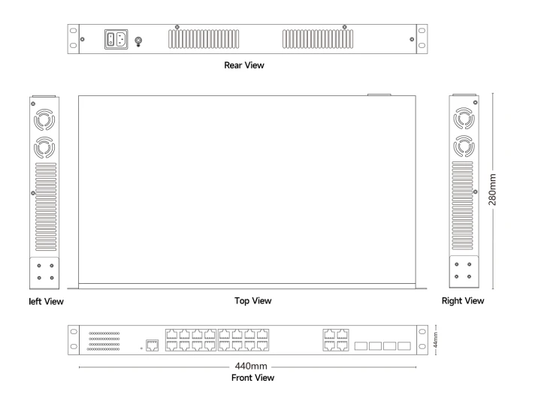
Commercial Ethernet Switch->2.5G Series
Commercial Ethernet Switch->2.5G Series
| Product Dimensions
www.scodeno.com

